Slide 1
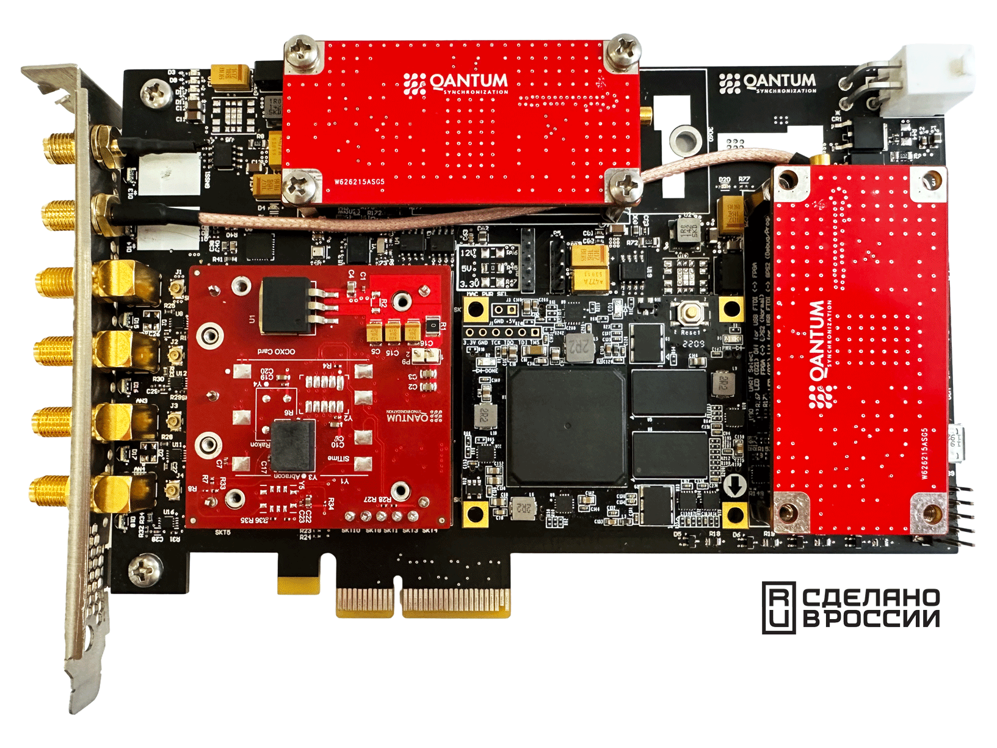
Qantum-PCI TimeCardTM
Qantum-PCI TimeCard es una solución avanzada y configurable para la sincronización de tiempo de precisión, que ofrece una exactitud y estabilidad insuperables para aplicaciones y servicios críticos.
Ventajas clave de Qantum-PCI:
Alta precisión: Logra precisión a nivel de nanosegundos para la sincronización de tiempo.
Amplia selección de osciladores: Qantum-PCI ofrece una gama diversa de osciladores para satisfacer necesidades diversas.
Interfaces flexibles: Soporta PTP, NTP, Sync-E y otros protocolos para garantizar la compatibilidad con diversos sistemas.
Facilidad de integración: Qantum-PCI se integra a la perfección con diferentes plataformas, incluyendo servidores, redes 5G O-RAN, clústers de IA.

Slide 2
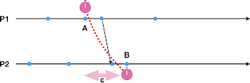
Преимущества точного времени
Coherency (Согласованность)
Efficiency (Эффективность)
Visibility
(Прозрачность)
Ensure that the data are the ▪
same on distributed devices
Reduce the number of data ▪
replicas
Reduce the hysteresis (ε uncertainty bound)
Have a clear view of the real order of events
Pre-schedule tasks to handle known low latencies
Measure latency to control bottlenecks
Allow coordinate actions → starting at same time increase the probability to finish at the same time
Pipelined assignments to improve efficiency
Carefully allocated resources to avoid any problems
9

Slide 3

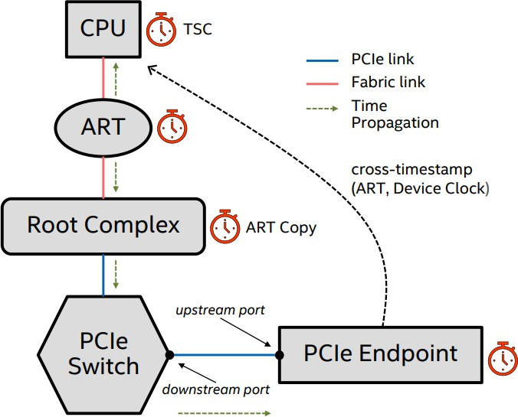


ВНЕДРЕНИЕ ВЫСОКОЙ ТОЧНОСТИ В ПРИЛОЖЕНИЯ
GNSS Timing Reference
PRTC-A | PRTC-B | ePRTC-A | …
Timing Distribution
WR (HATI)
PTP TC (1 to 5 hops)
Sundial, etc…
PTP OC Follower (OCXO on PCIe Node > PPS out)
PCIe Bus PTM (Precision Timing Measurement)
Always Running Timer ⬄ TSC (CPU Timer Core)
Точная синхронизация времени на уровне PCIe
Processor instructions
RDTSC | TPAUSE | …

Slide 4
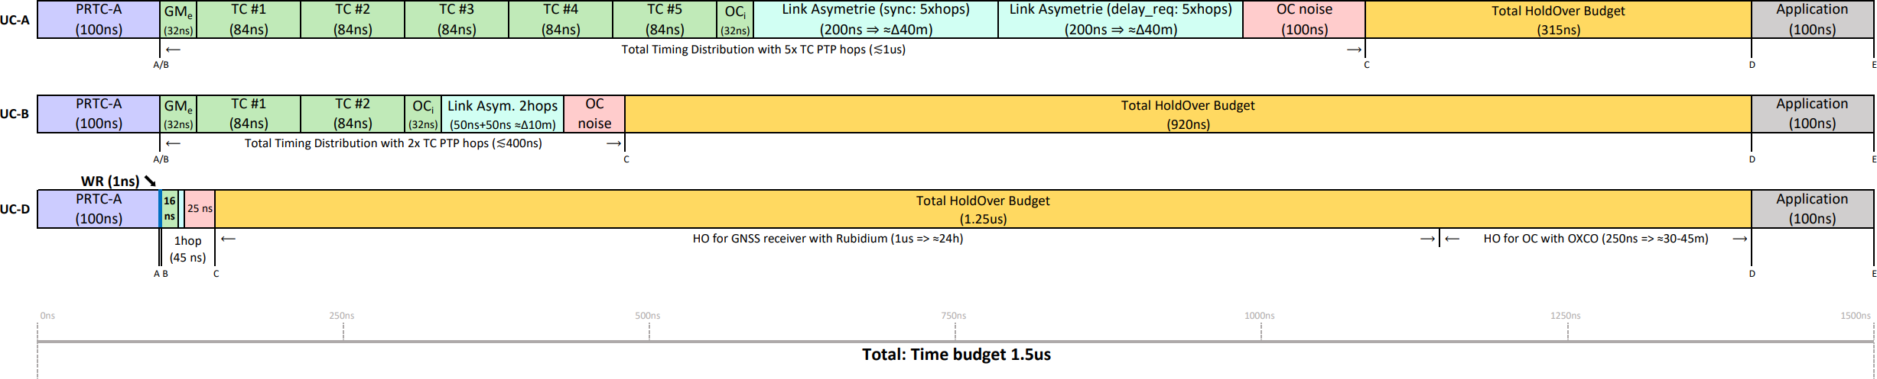
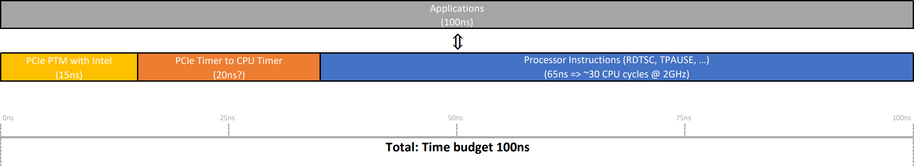
Сокращение абсолютного временного (1,5 мкс)
Повышение точности распределения времени позволяет увеличить времx автономной работы (holdover) и, следовательно, повысить устойчивость системы.

Slide 5
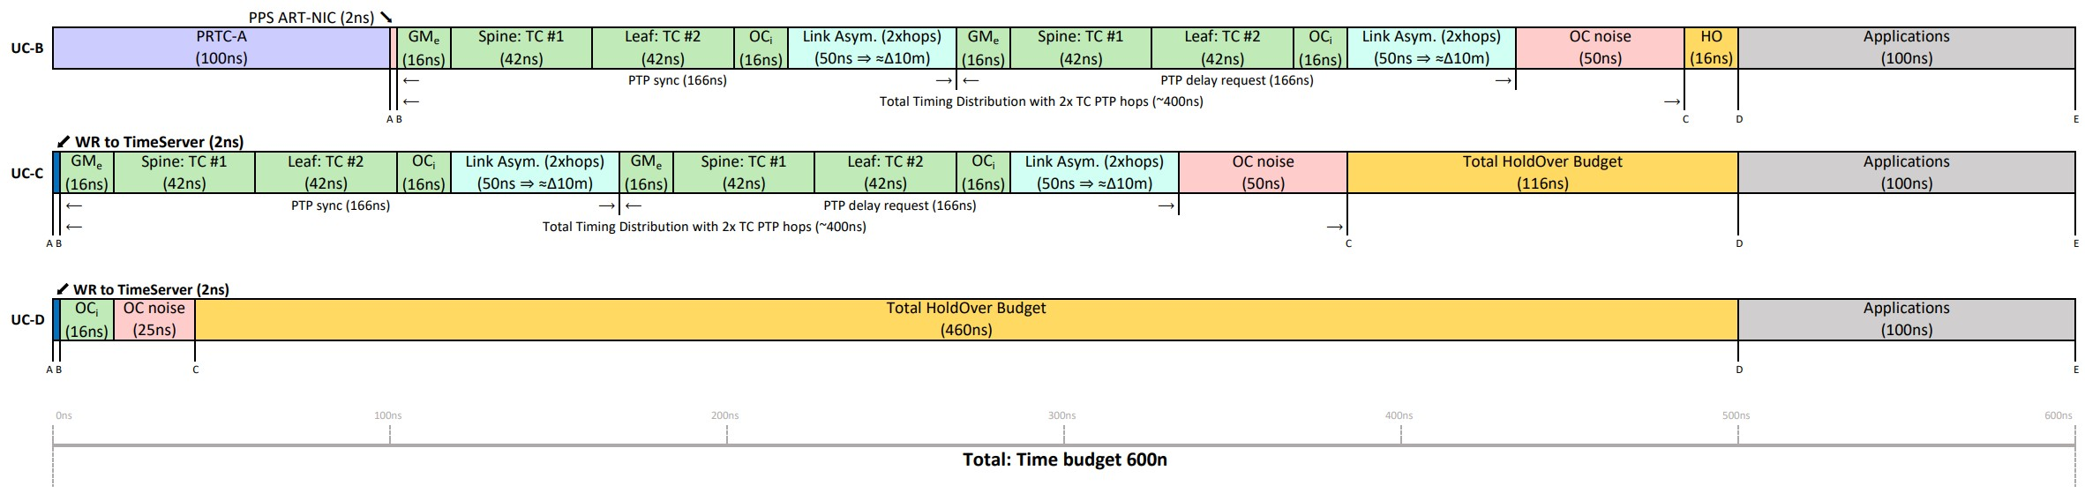
Относительный и абсолютный временной запас
Новое приложение: Вводятся в эксплуатацию новые приложения, требующие очень точной синхронизации времени для межсерверного анализа.
Требования: Приложение требует, чтобы все серверы в рамках одного регионального дата-центра выполняли определенные операции с точностью до 600 наносекунд.
Проблема с PTP: Существующая система синхронизации времени по протоколу PTP (PTP) имеет внутреннюю ошибку времени (ε) в 100 наносекунд (обозначается как PRTC-A). Это значит, что время на серверах в одном регионе может отличаться на 100 нc.
Решение с помощью WR: Технология WR позволяет распространять один и тот же эталонный часовой сигнал по всему региональному дата-центру.
Преимущества Qantum-PCI WR:
Устранение ошибки PRTC-A: Поскольку все серверы будут синхронизированы по WR, внутренняя ошибка PTP (PRTC-A) устраняется, и все серверы будут синхронизированы с точностью до 600 нc.
Увеличение времени автономной работы (holdover): В случае помех или сбоя GNSS сигнала, WR будет использовать встроенные атомные часы для обеспечения точного времени в режиме автономной работы. Благодаря устранению ошибки PRTC-A, время автономной работы не будет расходоваться на компенсацию этой ошибки.

Slide 6
EQUIVALENT TO 3GPP REQUIREMENTS
DC community (OCP-TAP) needs to agree on a set of requirements for each application/technologies:
Not only based on how well timing distribution performs
But answering what is the “theorical and meaningful” limit for a specific application
Telecom requirements (3GPP)
Datacenter requirements (???)
Tech / Application | Time-error
RU-GMC (DU-GMC) | ±1.5 µsec (±1.1 µsec) | Absolute
Intra-band non-contiguous CA | ±130 nsec | Relative
Inter-band CA | ±130 nsec | Relative
Coordinated Multi-Point (CoMP) | ±130 nsec | Relative
Intra-band contiguous Carrier Aggregation (CA) | ±65 nsec | Relative
MIMO / Transmit Diversity (Cat A+) | ±32 nsec | Relative
High-Accuracy Positioning Services (same DU) | ±10 nsec | Relative
Self-driving / Autonomous car | < 5 nsec | Relative
Tech / Application | Time-error (ε)
PTP DC Profile Timing distribution | ±2.5 µsec | Absolute | -
… | … | …
Coherent Database with low epsilon | ±100’s nsec[*] | Absolute | SW
… | … | …
Desagrated hardware (GPU, FPGA, DPU, etc..) | < ±100 nsec[*] | Relative | HW
Cross device events analysis for debugging | ±10’s nsec[*] | Relative | HW
High Frequency Trading Coordinate Action | ±10’s nsec[*] | Absolute | HW
High Frequency Trading Visibility Network | < ±1 nsec | Relative | HW
[*]: The provided value are to be defined and just provided as example to illustrate that more specific requirements are needed by the industry.

Slide 7
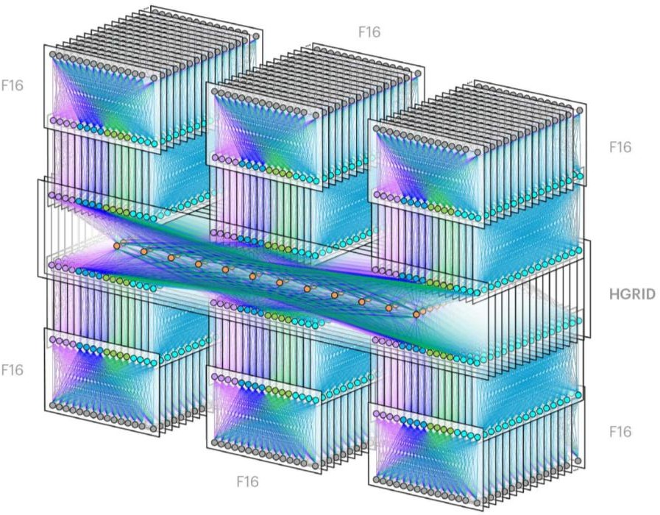
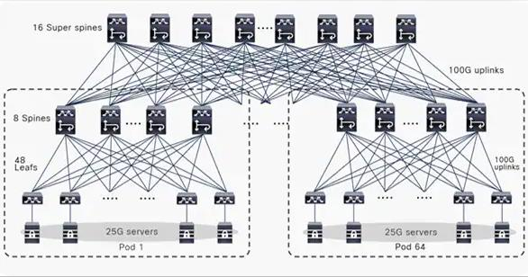
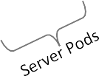
REFERENCE ARCHITECURES
1. Cisco 3-levels leaf/spine
2. Meta DC-Fabric (F16)
1 building
16 superspines
64 pods → 48 x racks/pod
~140K server/DC
1 Region → 6 buildings (F16)
16 fabric planes
48 pods → 48 x racks/pod
~100K servers/DC → ~600K servers/region
OCP-TAP: WR in datacenters

Slide 8


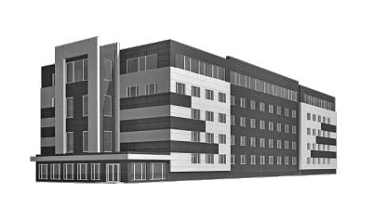
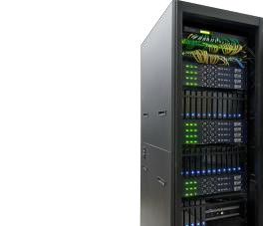

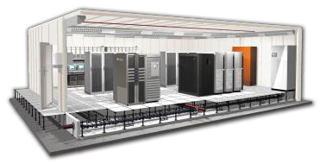
Слои синхронизации времени в дата-центрах
TL0 | TL1 | TL2 | TL3 | TL4
Intercity DC | Regional Area | Building Area | Pod Area | Rack Cabinet
>100km N+1 devices (N network hops) | <100km (metro) ~1-6 buildings | <10km ~64 pods | <100m ~48 racks | <10m ~40-48 servers
GNSS comparison “results from NY- Chicago tests” | DWDM channels Main GM (with Atomic Clock) | Dedicated fiber Backup GM with GNSS Antenna | Dedicated fiber High Port Density | Fiber (HATI/PTP) Coaxial (PPS) Copper (PTP)

Slide 9
UC-A: REFERENCE ARCH FOR DC PROFILE
Few Open Time Servers (GM) at the top of the DC to discipline all nodes
↓
Very Simple solution to put in place
GM
GM
GM
GM
…
…
TC
TC
TC
… …
…
… …
TC
TC
TC
Cost effective solution
No vendors lock-in
PTP Timing distribution ≈1us
Not scalable for hyperscale
>100’000 server → Open Time Servers CPU can not support
this load
TC
… …
…
…
TC
TC
TC
TC
TC
OC
OC
 | …
OC
TC
OC
OC
…
OC
TC
OC
OC
…
OC
TC
OC
OC
…
OC
TC
OC
OC
…
OC
…
…
OCP-TAP: WR in datacenters
9

Slide 10
UC-B: REFERENCE POD ARCH FOR DC PROFILE
4x Open Time Servers (GM) per pods
↓
Simple solution to put in place
Super spine
…
…
Super
spine
GM
GM
GM
GM
GM
GM
GM
GM
TC
… …
TC
…
TC
… …
TC
Reduce the number of hops
No vendors lock-in
GM handles between 5-15K clients
TC
… …
TC
…
…
TC
TC
TC
PTP Timing distribution ≈400ns
Many GNSS receivers to handle
TC
OC
OC
…
OC
TC
OC
OC
…
OC
TC
OC
OC …
OC
TC
OC
OC
…
OC
TC
OC
OC
…
OC
…
…
Complex RF installation: Splitter, Amplifiers
Many references can diverge ±100ns + calibration issues
OCP-TAP: WR in datacenters
10

Slide 11

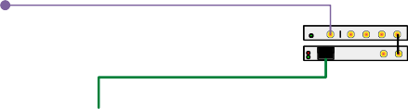
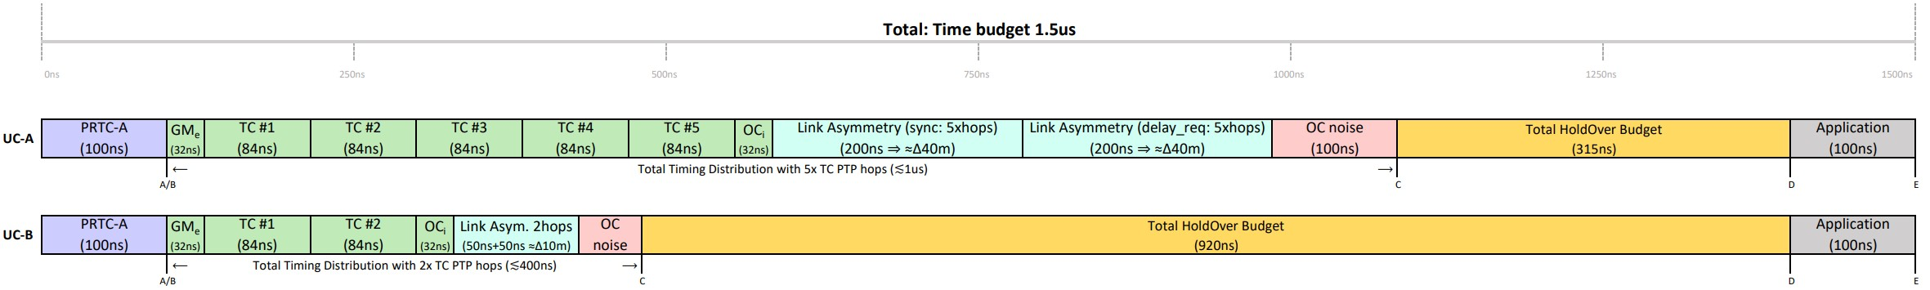
ART+NIC SOLUTIONS
UC-B: ART @ Top of Pod
UC-A: ART @ Top of DC
Reference Layer
Reference Layer
OPEN
TIME SERVER
_{ART} ART ^{GNS}
NIC
OPEN
TIME SERVER
_{ART} ART ^{GNS}
NIC
40 G/1 00G
40 G/1 00G
192
S pi ne 48 ports
por ts
Distribution
Layer
switch
TOR 48 ports
Distribution
Layer
S pi ne 48 ports
Client Layer
1U RACK SERVER
TOR 48 ports
For 64xpods/DC with at least 4xOpenTimerServer
➔ 256 GNSS antennas through DC
Client Layer
1U RACK SERVER
21

Slide 12
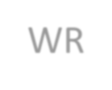
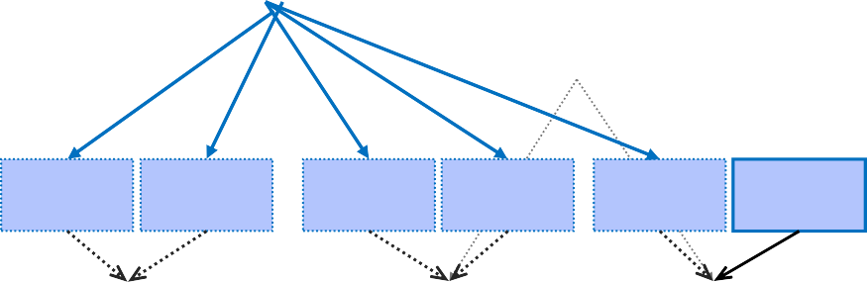
UC-C: WR TO THE TIME SERVER
GNSS
GNSS
Using WR at the core of DC to synchronize all PTP GM master (Open
Super spine
…
WR
…
Super
spine
Time Server)
↓
Simple solution to put in place
GM
GM
GM GM
GM
GM
GM
GM
TC
… …
TC
…
TC
… …
TC
Reduce the number of hops
GM handles between 5-15K clients
TC
… …
…
…
TC
TC
TC
TC
Sharing a common clock (<1ns accuracy)
Linked clocks increase resiliency and accuracy
Solution for intra-DC and inter-DC
Only 1 or 2 GNSS receivers to install
TC
OC
OC
 | …
OC
TC
OC
OC
…
OC
TC
OC
OC …
OC
TC
TC
…
OC
…
OC
PTP Timing distribution ≈400ns
Relative accuracy is reduced by ±100ns
OC
OC
…
…
OC
OC
OCP-TAP: WR in datacenters
22

Slide 13
INTER DC TRIANGLES
A resilient solution by design with a
triangle between 3xDC in the same
regional area (metro-area)
DC #B
DC #C
Secure Sync 2400
Secure Sync
↓
GNSS
GNSS
WR-Z16
IN OUT
2400
W
R-Z 16
GMb
GMc
OUT
1PPS10M Hz 1PPS10M Hz
IN
DWDM (60km)
1PPS10M Hz 1PPS10M Hz
DC#A has by default the main/active GMa
WR
WR
Upper Timing Distribution Layer
PTP
Lower Timing Distribution Layer
Upper Timing Distribution Layer
PTP
The GMb & GMc only monitor their GNSS offset in respect to WR from GMa
Lower Timing Distribution Layer
PTP OC Client Layer
DC #A
PTP OC Client Layer
Secure Sync
GNSS
2400
WR-Z16
IN OUT
1PPS10M Hz 1PPS10M Hz
The link betweem GMb-GMc is in survey mode (only used to compute offset)
DWDM (40km)
GMa
DWDM (25km)
WR
WR-Z16
IN OUT
1PPS10M Hz 1PPS10M Hz
Upper Timing Distribution Layer
DUT
PTP
DUT has been placed below GMa but could be placed anywhere.
Lower Timing Distribution Layer
PTP OC Client Layer
OCP-TAP: WR in datacenters

Slide 14
INTER DC TRIANGLES (FAILURE)
If a spoofing attack is executed on GMa
the linked-triangle will detect abnormal
behavior and select a new GW
DC #B
DC #C
↓
GNSS
Secure Sy nc 2400
GNSS
Secure Sy nc 2400
W
R-Z 16
T
GMb
WR-Z16
GMc
IN OU
IN OUT
A simple voting mechanism between at least 3 participants is always run-in background
1PPS10M Hz 1PPS10M Hz
DWDM (60km)
1PPS10M Hz 1PPS10M Hz
WR
WR
Upper Timing Distribution Layer
PTP
Lower Timing Distribution Layer
Upper Timing Distribution Layer
The majority should not drift away from the mTIE>100ns
(PRTC-a)
PTP
Lower Timing Distribution Layer
PTP OC Client Layer
DC #A
PTP OC Client Layer
When drift is detected on GMa it will stop being the active GM and enter HO mode
Secure Sy nc
GNSS
2400
WR-Z16
IN OUT
1PPS10M Hz 1PPS10M Hz
GMa
Meanwhile the next valid timing source GMb become the active GM
DWDM (40km)
WR
DWDM (25km)
Upper Timing Distribution Layer
WR-Z16
IN OUT
1PPS10M Hz 1PPS10M Hz
DUT
PTP
The GMa & GMc become slave of the GMb but continue monitoring their GNSS offset
Lower Timing Distribution Layer
PTP OC Client Layer
The DUT smoothly transition from GMa to GMb
OCP-TAP: WR in datacenters

Slide 15
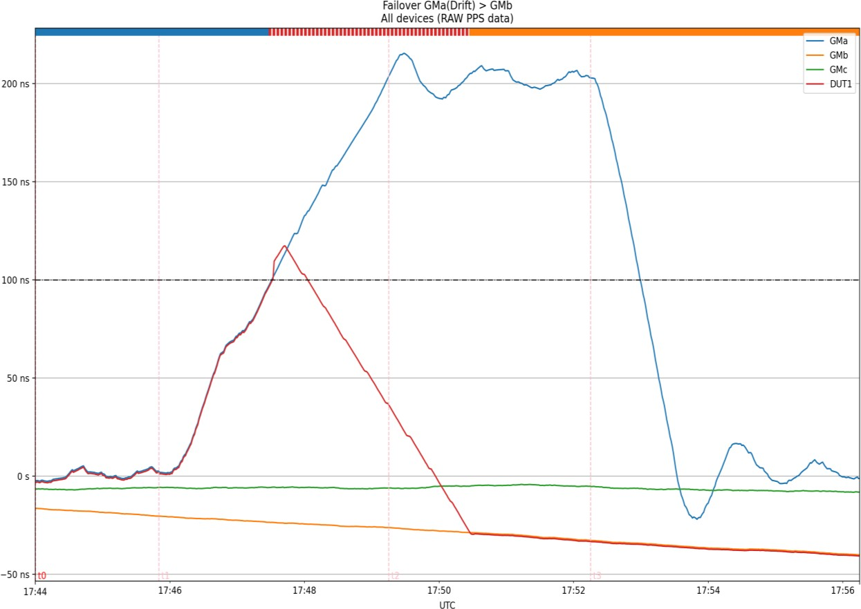
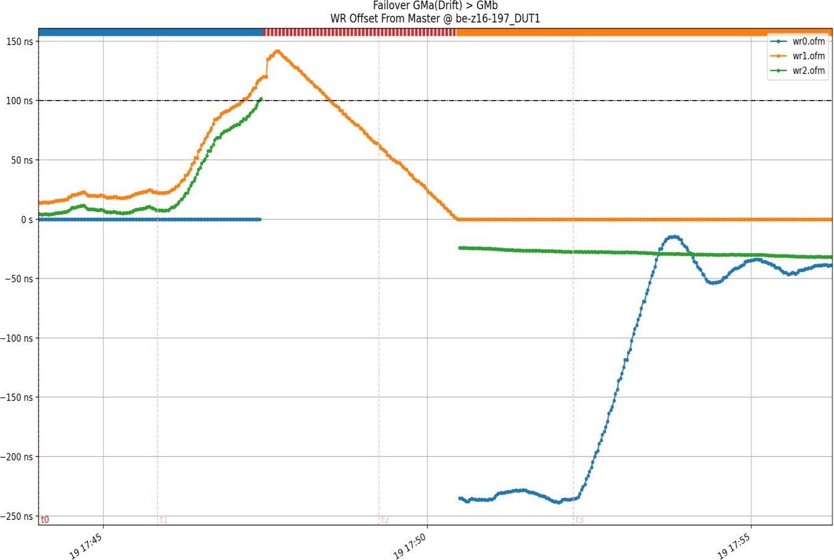
EXAMPLE: FAILOVER WITH DRIFT DETECTION @ GM_{A}
External lab measurement
View from the monitoring framework
OCP-TAP: WR in datacenters

Slide 16

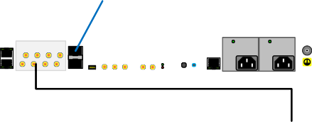

C: WR TO THE TIME SERVER
C1: Through PPS cable
C2: Through HATI NIC
Reference
Reference
Layer
GNSS
S ecure Sy nc 2 400
Layer
GNSS
SecureSync 2400
WR-Z 16
WR-Z16
IN OUT
1PPS10M Hz 1PPS10M Hz
Distribution
IN O UT
1PPS10M H1zPPS10MHz
Distribution Down Layer
FPO 8x
WR-Z EN TP-FL
Down Layer
TIME SERVER
OUT IN
10M SI NCLKTTL 1PS 1PS 1M0Hz
Distribution
QSFP+ QSFP+ Sm ar t NI C
TIME SERVER
Up Layer
Spine 48 ports
Distribution
40 /100 G
Up Layer
S pi ne 48 ports
TOR 48 ports
TOR 48 ports
Client Layer
1U RACK SERVER
Client
1U RACK SERVER
Layer
Any 40G/100G NIC cards with PPS input can works
Adding extra WR-TPFL device with FPO to provide up
to 8xPPS (4xPPS/4x10MHz)
HATI can forward clock information (TAI, Class, Accuracy, Leapsec, …) from GNSS to the Time Server
Ongoing Solution…
OCP-TAP: WR in datacenters

Slide 17


HATI-SMARTNIC
WR timing network
vcxo
HATI is an IP-core embedded in FPGA
At least 1x10G link is reserved for WR
For Redundancy: HARTI can be used and will consume 2x10G links.
1PPS/Clk/ToD are forwarded to the
user IP-cores
SMA
1PPS
10G
GTx
HA(R)TI IP-CORE
1PPS
ToD
CLK
Timing User IP-Cores
10G
GTx
QSFP
GTx
GTx
Mgt*
User IP-Cores
User Endpoints IP-Cores
Crossbar
QSFP
GTx
40G
GTx
GTx
Local oscillator of smartNIC can be disciplined with sub-ns accuracy (through WR-HATI)
Outgoing PTP packets are timestamps with sub-ns accuracy (from HATI-WR)
GTx
FPGA (Xilinx)
PCIe
SmartNIC
PTP daemon (GM)
PTP data network
Time Server (CPU)
OCP-TAP: WR in datacenters

Slide 18
HATI – NATIVE WHITE RABBIT SUPPORT
HATI is being integrated with Arista, Cisco and LDA Technologies L1-switches.
High Accuracy timing integration in Xilinx FPGAs (including US+).
Sub-nanosecond time accuracy on NICs can be achieved leveraging this technology.
No need for expensive oscillators/clocks or dedicated hardware.
Distribution over fiber without calibration. Remove the need for coaxial cables.

Slide 19
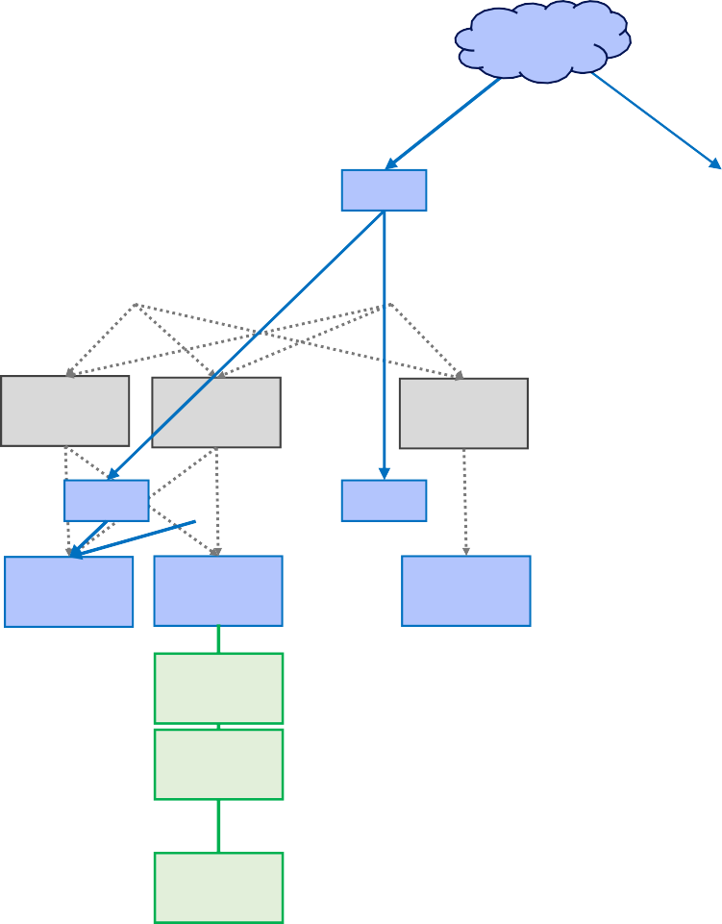
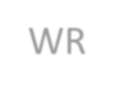
UC-D: WR UNTIL TOR
Timing network and data network are independent until TOR that works as PTP BC
↓
Integration of HATI into TOR FPGA
GNSS
GNSS
WR
Super spine
…
…
Super spine
…
WR WR
WR WR
… …
…
… …
Spine
Spine
Spine
Spine
… …
Leaf …
… Leaf
Leaf
Leaf
Leaf
Accuracy @ TOR BC → <1ns
Few PTP clients (<50) for TOR BC Only 1 hops PTP
…
…
WR
WR
WR
WR
WR
WR
WR WR
HATI-WR
HATI-WR BC TOR
HATI-WR BC TOR
HATI-WR BC TOR
OC
OC
…
OC
HATI-WR BC TOR
OC
OC
…
OC
BC TOR
… …
Accuracy @ OC Server → 10’s ns
Resilient solution
OC NIC can be very basic
Adding a parallel timing network
OC
…
OC
OC
OC
OC
…
OC
… …
OC
OC
OC
OCP-TAP: WR in datacenters
19

Slide 20

UC-D: WR UNTIL TOR
Timing network and data network
are independent only TOR
↓
Integration of HATI into TOR FPGA
Data only
Reference
Layer
GNSS
S ecure Sync 2400
192
por ts switch
WR
-Z 16
IN OUT
1PPS10M Hz 1PPS10M Hz
Accuracy @ TOR BC → <1ns
Few PTP clients (<50) for TOR BC Only 1 hops PTP
Distribution
Layer
WR-Z 16
IN OUT
1PPS10M Hz 1PPS10M Hz
WR-Z 16
IN OUT
1PPS10M Hz 1PPS10M Hz
S pi ne 48 ports
HA TI-TOR 48 ports
Accuracy @ OC Server → 10’s ns
Resilient solution
Adding a parallel timing network
Client Layer
1U RACK SERVER
OCP-TAP: WR in datacenters
20

Slide 21
RECAP: TIME BUDGET OPTIMIZATION
Improving accuracy for timing distribution allows to increase holdover budget and thus to enhance resiliency
Through WR a common clock is shared among the DC and thus it allows to:
Remove PTRC-A time-error.
Dedicate Holdover budget to final OC node
OCP-TAP: WR in datacenters
21

Slide 22
UC-A/B: DETECTION OF ROGUE TC
Internal cross-check to ensure linearization must be used to detect Rogue TC
GM
GM
GM
GM
…
…
TC
TC
Checking only OC in the same rack might result in OK value.
TC
… …
…
… …
TC
TC
TC
Need to find where the results start to diverge
TC
… …
…
…
TC
TC
TC
TC
Consuming network bandwidth and CPU cycles for timing checking
TC
OC
OC
…
OC
TC
OC
OC
…
OC
TC
OC
OC
…
OC
TC
OC
OC
…
OC
TC
OC
OC
…
OC
…
…
Windows of uncertainty, Ahmad Byagowi (Meta), OCP-TAP
OCP-TAP: WR in datacenters
33

Slide 23
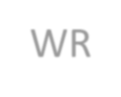
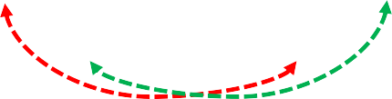
UC-E: SURVEY WITH WR SUPPORT
WR
Add few strategically placed WR devices to act as ground-truth for PTP OC clients.
↓
Ground-truth devices are disciplined by WR with sub-ns accuracy
Mainly used as monitoring device by measuring PTP communication from OC
GM
GM
GM
GM
…WR
…
WR …
TC
TC
… …
…
… …
TC
TC
TC
TC
TC
… …
…
…
TC
TC
TC
TC
TC
TC
TC
TC
TC
OC
OC
 | …
OC
OC
OC
…
OC
OC … …
OC
OC
OC
OC
… …
…
…
OC
OC
OC
OC
…
…
WR
WR
WR
WR
OCP-TAP: WR in datacenters
23

Slide 24

UC-F: WR как эталон точного времени
WR
Insert some probes in small percent of servers (ideally 1/rack)
↓
Ground-truth devices are disciplined by WR with sub-ns accuracy
Only used as monitoring device by measuring PTP communication from OC (1-hop TC)
Can be used as PTP ground-truth master to enhance any cross- exchange PTP solution (i.e., SquarePTP).
GM
GM
GM
GM
…WR
…
WR …
TC
TC
… …
…
… …
TC
TC
TC
TC
TC
TC
… …
…
…
TC
TC
TC
…
…
TC
OC
OC
 | …
OC +WR
TC
TC
OC
OC
…
OC +WR
TC
TC
OC
…
OC … …
OC
OC
OC
…
OC
…
…
OC
+WR
OC
+WR
OC
+WR
WR
WR
WR
WR
OCP-TAP: WR in datacenters
24

Slide 25
RESUMING USE-CASES
UC-A: Open Time Server above super-spine
Simple to install but can not handle hyperscale DC numbers (>10K clients)
UC-B: Open Time Server per pods
Complex RF installation with calibration issue
UC-C1: WR at core providing PPS to the GM
Common clock shared across intra/inter-DC: needs extra TPFL-FPO device, no clock information forward to PTP GM.
UC-C2: WR at core providing PPS to a HATI compatible smartNIC
Common clock shared across intra/inter-DC: needs smartNIC HATI compatible.
UC-D: WR timing until TOR device
All TOR share the same clock, 10’ns accuracy at OC with only 1-hop PTP. A parallel timing network is needed.
UC-E: PTP Survey using scattered WR-Z16 devices
Few strategically placed WR devices needed per pod to measure PTP offset. Can only be used to measure quality of link.
UC-F: Some ground truth server with PTP+WR (using HATI-NIC)
Ideally 1 PTP-HATI NIC per rack to provide ground-truth allowing to enhance other protocols (i.e. PTP square)
OCP-TAP: WR in datacenters

Slide 26
Преимущества использования Qantum-PCI в дата-центрах:
Увеличение времени
работы в автономном режиме (holdover).
Создание более надежных
и устойчивых систем.
Повышение точности
синхронизации времени.
Создание основы для
будущих высокоточных приложений.
OCP-TAP: WR in datacenters

